Slide 1

Final Project Case Study in the Arts
Morgan, Nick
CSCI E-89 Deep Learning, Spring 2019
Harvard University Extension School
Prof. Zoran B. Djordjević

Slide 2
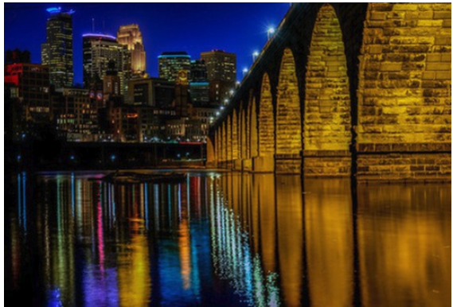
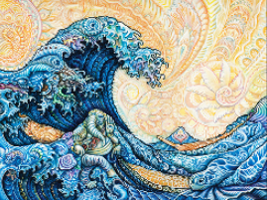
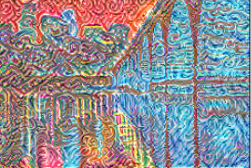
Introduction
Problem: The analysis will explore whether it is possible to capture the style of an image, and apply it to another image – creating art. This problem will be researched using Tensorflow on the VGG-19 pre-trained Network
Background:
The VGG-19 Network was originally used to classify objects in an image
By using convolutional layers in this network, we can separate content and style
By separating the style from an image, we can use it to transform another image

Slide 3




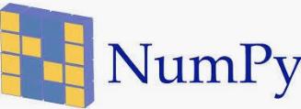

Software and Technology
Anaconda
Python (Version 3.6.3)
Jupyter Notebook
Packages:
tensorflow
numpy
scipy
matplotlib
PIL
Pre-trained model:
imagenet-vgg-verydeep-19, from the
Visual Geometry Group

Slide 4
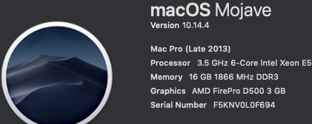
My Hardware Environment
Operating System: OSX

Slide 5
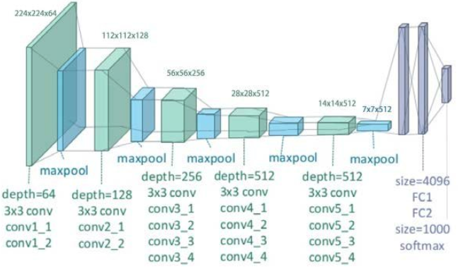
DataSet
I use a pre-trained model, VGG19, which was trained on over 1 million images available on http://www.image-net.org/
This original model is available in tf.keras.applications.vgg19, but I used a different model [1], [2], which replaces maxpool with averagepool
Once the model is loaded, the only data required is the content image and the style image

Slide 6
Overview of Steps
Install required packages
Download pre-trained vgg19 model with maxpooling replaced by averagepooling
Open my notebook, CSCI_E89_Final_Nick_Morgan
Run all cells through (and including) the definition of run_style_transfer()
Run the next cell, keeping the defaults, or change the content_path and style_path to generate different images
View the output/ directory to view the generated images

Slide 7
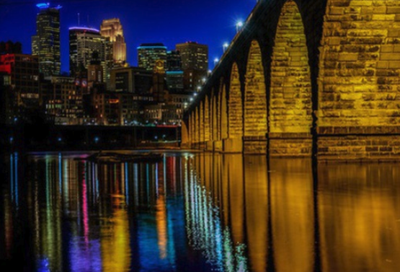
Data Visualization – Content Image
Photo Credit: Mac H (media601) on flickr

Slide 8
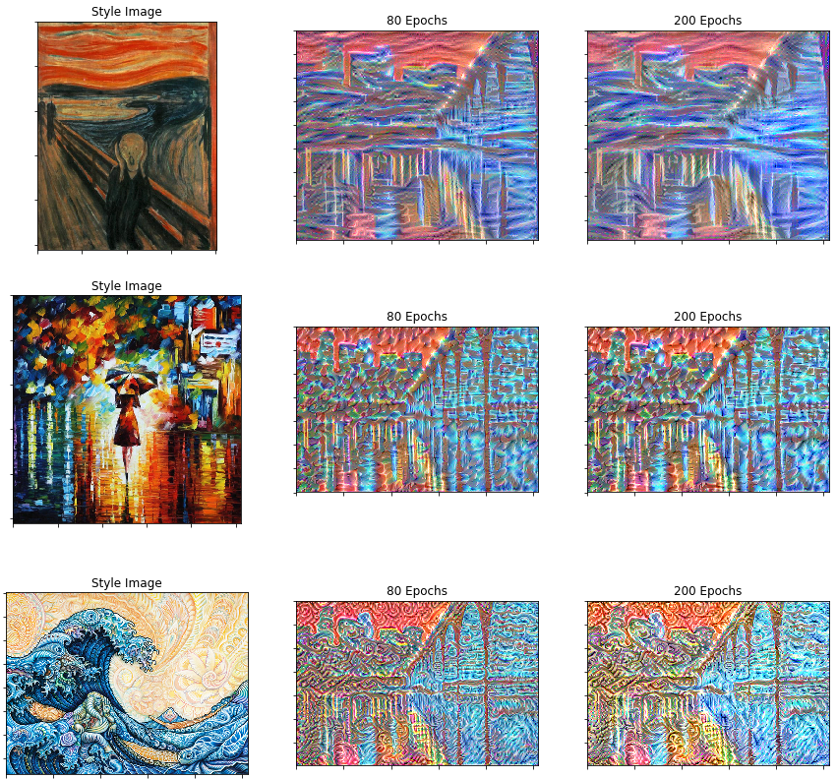
Data Visualization – Transformations

Slide 9
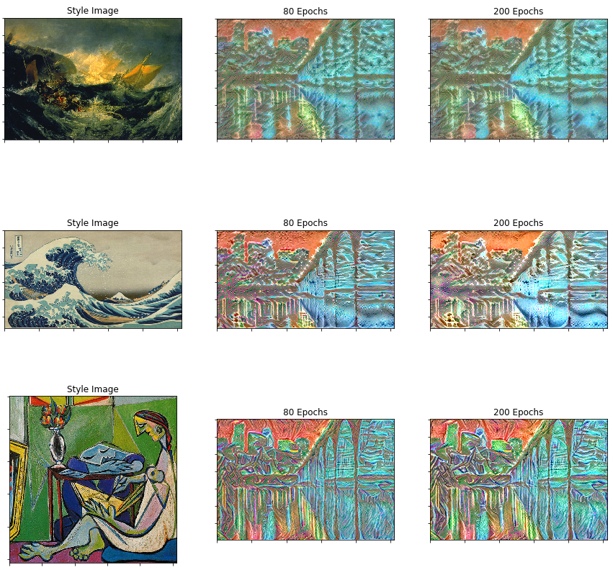
Data Visualization – Transformations

Slide 10
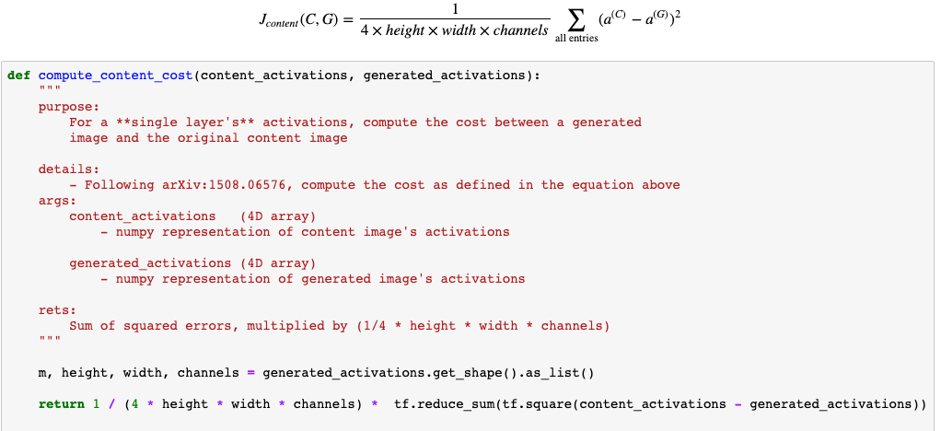
Code Overview
Create content_loss_function
Create style_loss_function
Optimize

Slide 11
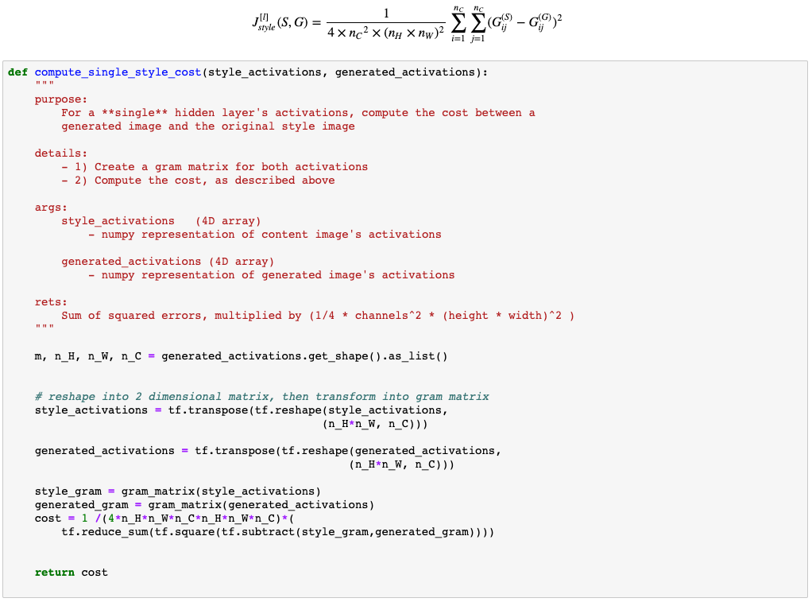
Code Overview
Create content_loss_function
Create style_loss_function
Optimize

Slide 12
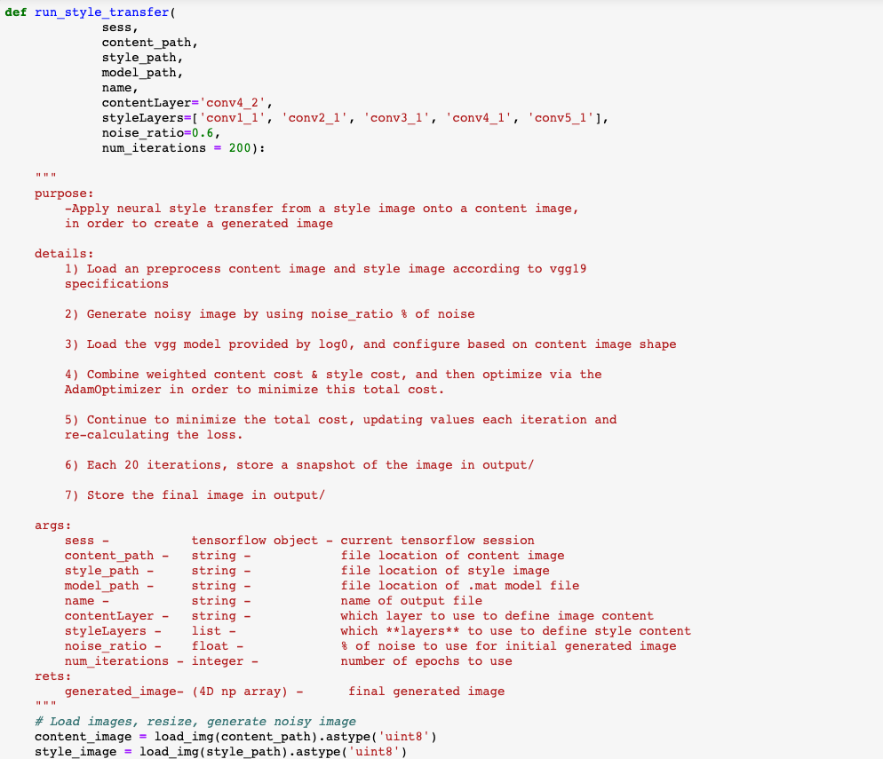
Code Overview
Create content_loss_function
Create style_loss_function
Optimize

Slide 13
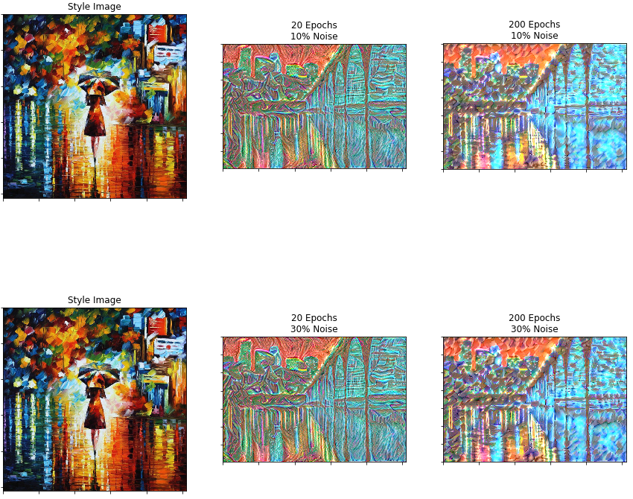
Additional Results – Effect of Noise

Slide 14
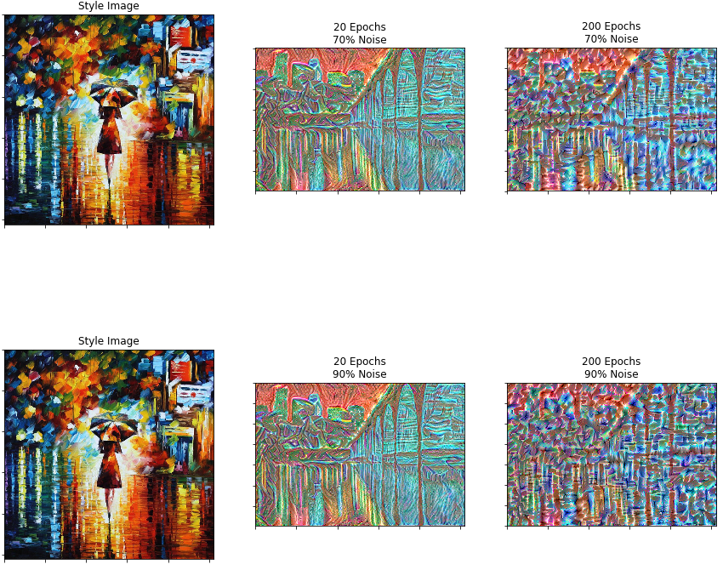
Additional Results – Effect of Noise

Slide 15
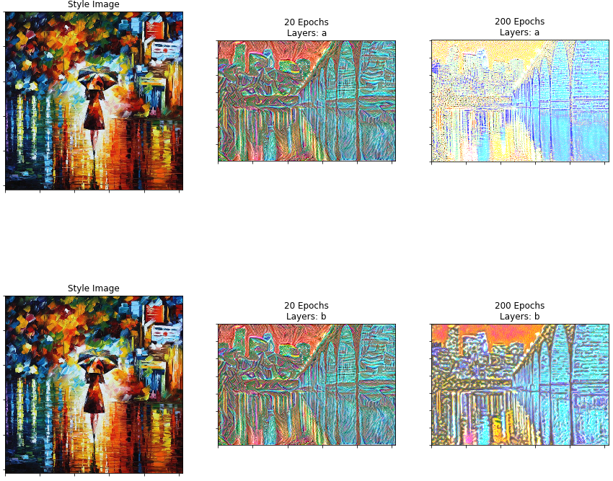
Additional Results – Effect of Style Layers

Slide 16
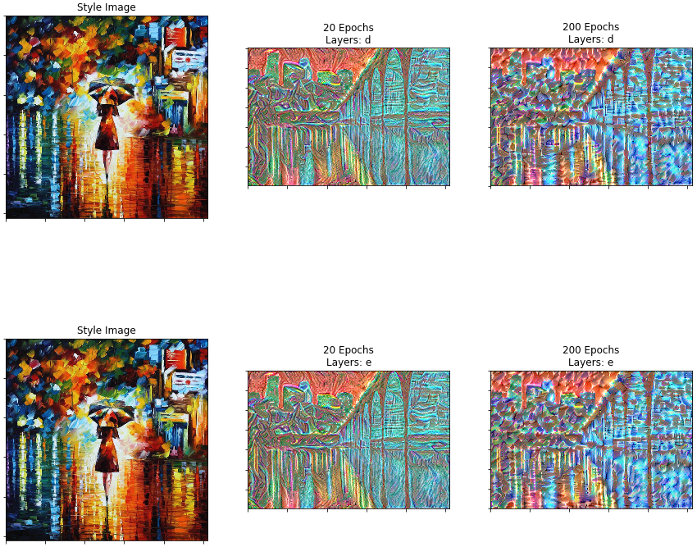
Additional Results – Effect of Style Layers

Slide 17
Lessons Learned
Higher layers of the VGG19 network capture content of an image, whereas the lower layers seem to emulate each individual pixel (analogous to an overfit)
Taking correlations of activations between networks can effectively capture the style of an image
Using averagepooling instead of maxpooling improves the results of the final image

Slide 18
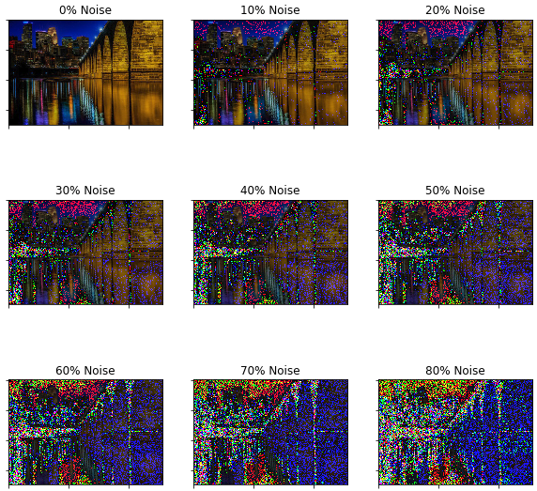
Lessons Learned
Adding noise to the initial generated image has a drastic effect on the final outcome

Slide 19
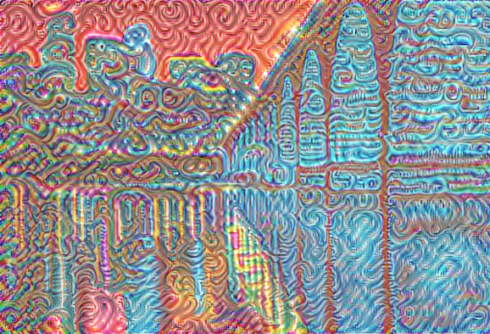
Future Work
Two style images
could potentially be combined
and weighted to capture
multiple style transformations
on a single image
One could isolate and
segment portions of an image
in order to apply separate
style transformations to
different sections of the image

Slide 20
YouTube URLs, Last Page
Two minute (short): https://youtu.be/s8wsUmSlRAI
15 minutes (long): https://youtu.be/e5boqXn_Qc8

